Slide 1
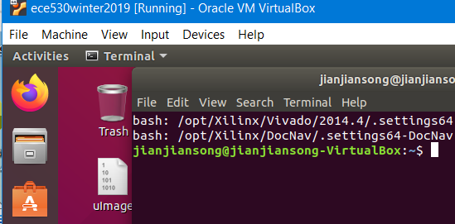
Lecture 11 Lab #10 Embedded Linux with Zybo
References
Files Needed to Boot Linux Operation System
Booting Sequence
Booting procedures
Interactive from XSDB (Xilinx System Debugger)
From QSPI flash or micro SD card
Zynq Linux Boot Loader
U-boot, Ramdisk, BOOT.bin
Device Tree
Vivado 2014.4 cross-compile tool chain
Lab #10: Boot Linux for Zybo Base System Design
Generate system wrapper, bit stream, u-boot, boot.bin, uImage, ram disk, device tree, myled.ko, led_blink

Slide 2
References
Embedded Linux Development Guide, January 14, 2013, Digilent
Embedded Linux® Hands-on Tutorial for the ZYBO™ Revised July 17, 2014, Digilent
Getting Started with embedded Linux – ZedBoard, Digilent
Zybo Base System Design, https://reference.digilentinc.com/zybo:zybo., Digilent
Xilinx Zynq U-Boot, http://www.wiki.xilinx.com/U-boot.
Xilinx UG1165 , Chapter 6 Linux Booting and Debug in SDK, Zynq-7000 All Programmable SoC: Embedded Design Tutorial, A Hands-On Guide to Effective Embedded System Design, UG1165 (v2015.1) April 23, 2015, (PetaLinux)
Xilinx UG821, Zynq-7000 All Programmable SoC Software Developers Guide UG821 (v12.0) September 30, 2015, (Boot Modes and Boot Stages)

Slide 3
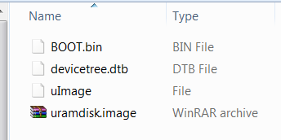
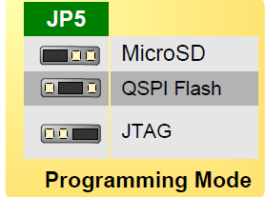
Files Needed to Boot Linux Kernel as 2nd Stage Boot Process
BOOT.BIN
boot image created by Xilinx SDK, FSBL, bit stream, application.
U-boot.elf – Second Stage Bootloader (SSBL)
U-Boot.elf – SSBL
U-Boot is an open source bootloader that is frequently used in the Linux community to start Linux
uImage – Digilent Linux kernel image
Devicetree.dtb
device tree blob (DTB file)
Uramdisk.image
file system in RAM
This may need to be wrapped into u-boot header for Linux
These files can be stored on a micro SD card
Linux kernel can be booted from the SD card when JP5 on MicroSD.

Slide 4
Boot Sequence (from Zybo Reference Manual V6)
Stage 0 – from Read-Only BootROM
After the ZYBO is powered on or the Zynq is reset (in software or by pressing PS-SRST)
one of the processors (CPU0) begins executing an internal piece of read-only code called the BootROM.
If and only if the Zynq was just powered on, the BootROM will first latch the state of the mode pins into the mode register (the mode pins are attached to JP5 on the ZYBO).
If the BootROM is being executed due to a reset event, then the mode pins are not latched, and the previous state of the mode register is used.
Next, the BootROM copies an FSBL (First Stage Boot Loader) from the form of non-volatile memory specified by the mode register to the 256 KB of internal RAM within the APU (called On-Chip Memory, or OCM).
The FSBL must be wrapped up in a Zynq Boot Image in order for the BootROM to properly copy it.
The last thing the BootROM does is hand off execution to the FSBL in OCM (On-Chip Memory).
Chapter 3 Boot and Configuration, ug821 Zynq-7000 Software Development Guide

Slide 5
Boot Sequence (from Zybo Reference Manual V6)
Stage 1 - First Stage Boot Loader
During this stage, the FSBL first finishes configuring the PS components, such as the DDR memory controller. Then, if a bit stream is present in the Zynq Boot Image, it is read and used to configure the PL. Finally, the user application is loaded into memory from the Zynq Boot Image, and execution is handed off to it.
The FSBL boot code is typically stored in one of the flash memories, or can be downloaded through JTAG. BootROM code copies the FSBL boot code from the chosen flash memory to on-chip memory (OCM). The size of the FSBL loaded into OCM is limited to 192 kilobyte. The full 256 kilobyte is available after the FSBL begins executing.
The FSBL boot code is completely under user control and is referred to as user boot code.
Stage 2 – second stage boot loader to boot Application or Linux
The last stage is the execution of the user application that was loaded by the FSBL. This can be any sort of program, from a simple “Hello World” design, to a Second Stage Boot loader used to boot an operating system like Linux.
Chapter 3 Boot and Configuration, ug821 Zynq-7000 Software Development Guide

Slide 6
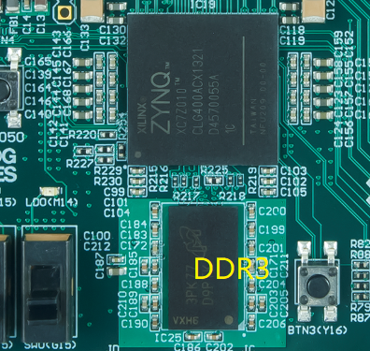
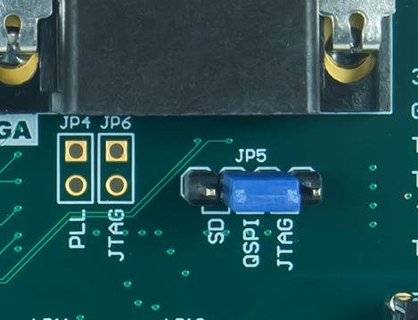
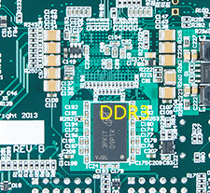
The BootROM on Chip Boot Process – Stage 0
The BootROM starts Stage 0 Boot Loader
Check the BootMode pins to determine where to find the First Stage Bootloader (FSBL) or BOOT.bin file
JTAG
QSPI Flash
NAND Flash
NOR Flash (IC21, S25FL128SAGMFI00, Cypress Semi)
SD Card
Chapter 3 Boot and Configuration, ug821 Zynq-7000 Software Development Guide

Slide 7
BOOT.bin and First Stage Bootloader (FSBL)
BOOT.bin may contain FSBL, bitstream file, and Second Stage Bootloader such as u-boot.
The BootROM loads BOOT.bin and the FSBL into on-chip memory (OCM) from an external storage device such as microSD
The FSBL is responsible for:
Initializing with the PS configuration data that Xilinx hardware configuration tools provide.
Programming the PL using a bit stream (if provided).
Loading second stage bootloader or bare-metal application code into DDR memory.
Handoff to the second stage bootloader or bare-metal application.
the FSBL invalidates the instruction cache and disables the cache and MMU before handoff to the second stage bootloader or bare-metal application.
Chapter 3 Boot and Configuration, ug821 Zynq-7000 Software Development Guide

Slide 8
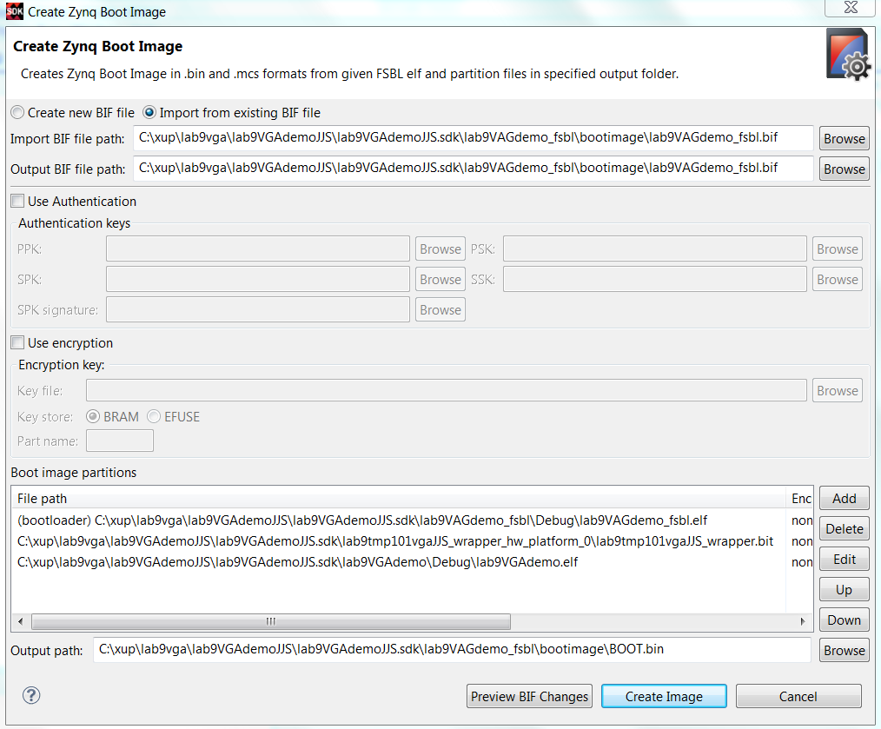
An Example BOOT.bin with Bare-Metal Application: Lab #9 VGA Display
Boot image file BOOT.bin includes three files in this required order
Bootloader FSBL.elf (executable and loader file)
Bit stream file *.bit for PL configuration (optional)
Application file *.elf for bare-metal application (executable and loader file)
The application ELF must have DDR address of greater than 1Mb.
BOOT.bin can be stored in either SD or QSPI
output.bif
BIF file (Boot Image Format)
BootROM header
FSBL image
One or more partition images
Unused space, if available
Chapter 3 Boot and Configuration, ug821 Zynq-7000 Software Development Guide

Slide 9
Second Stage Bootloader Example: U-BOOT
The second stage bootloader is optional and user-designed.
U-Boot is an open source bootloader that is frequently used in the Linux community, and used by Xilinx for the MicroBlaze™ processor and the Zynq-7000 AP SoC processor for Linux.
To bring operating system into memory from the OS media.
To load and execute images from Ethernet, flash memory, SD/MMC, and USB.
The ability to start a Kernel image from memory.
Availability of a command interpreter with many commands such as: reading and writing to/from memory, and network operations, such as the ping command.
U-boot could be wrapped into BOOT.bin
Chapter 3 Boot and Configuration, ug821 Zynq-7000 Software Development Guide

Slide 10
U-BOOT in Action
Start the procedure autoboot
Autoboot looks for the BootMode pin settings for the source of the kernel image in this case the SD card
Start the procedure sdboot if the source is SD card
sdboot does three things
Read the kernel image, .e.g, uImage or zImage from the FAT partition and copies it to 0x00008000
Read the device tree DTB file, e.g., devicetree.dtb and load it to 0x01000000
Read the zipped ramdisk file system, e.g., uramdisk.image.gz and load it to 0x00800000
Start the kernel image from 0x00008000
Embedded Linux Development Guide, Digilent

Slide 11
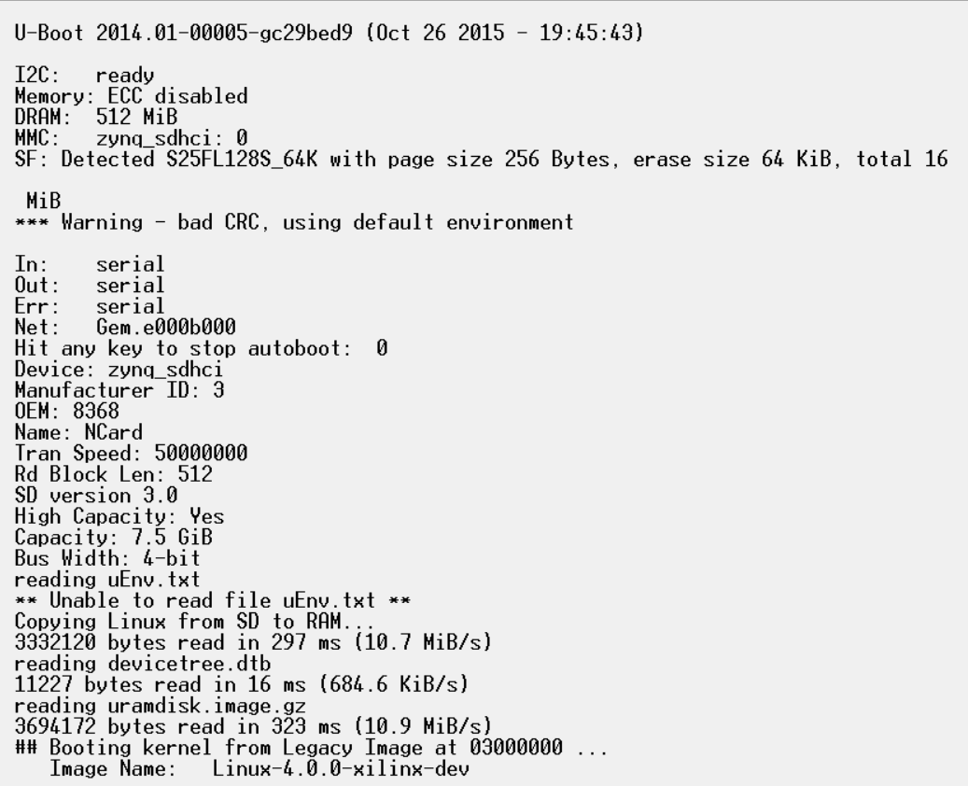
Embedded Linux Development Guide, Digilent

Slide 12
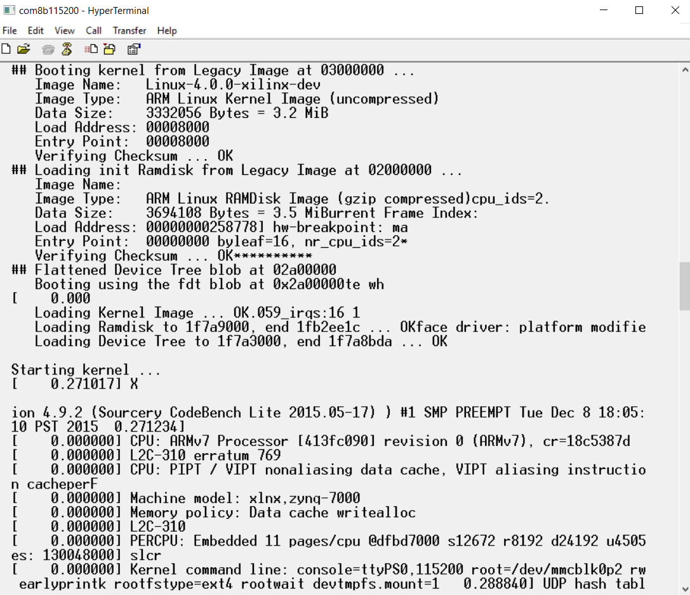
Embedded Linux Development Guide, Digilent

Slide 13
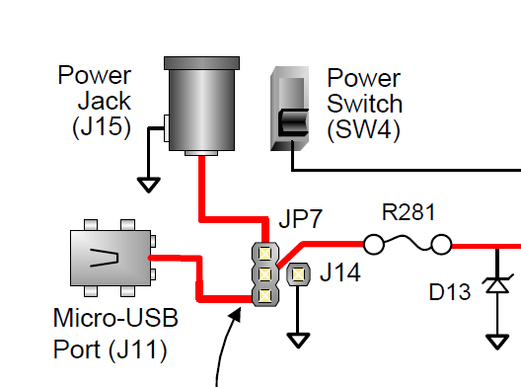
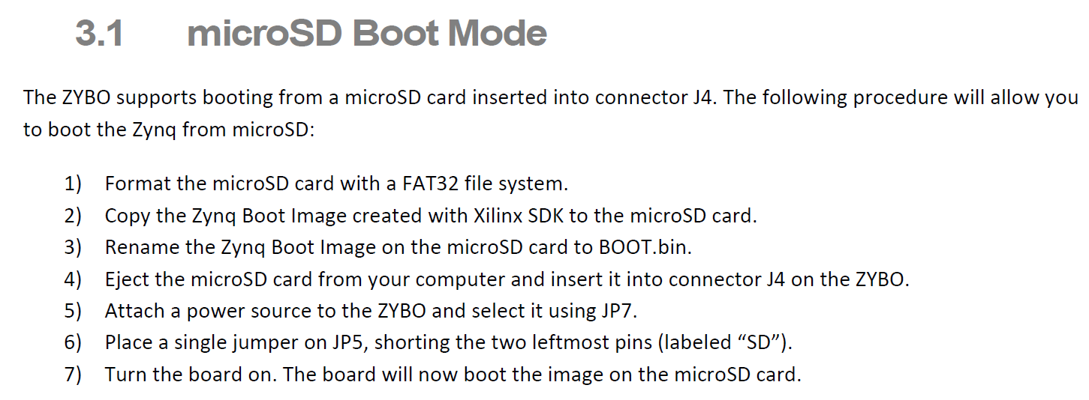
Boot Linux on Zybo from Digilent Inc.
Copy four files onto a MicroSD card
BOOT.bin
uImage – unzipped Linux kernel file
uramdisk.image.gz
devicetree.dtb

Slide 14
MicroSD Boot Mode (from Zybo Reference Manual V6)
The ZYBO supports booting from a microSD card inserted into connector J4. The following procedure will allow you to boot the Zynq from microSD:
Format the microSD card with a FAT32 file system.
Copy the Zynq Boot Image created with Xilinx SDK to the microSD card.
Rename the Zynq Boot Image on the microSD card to BOOT.bin.
Eject the microSD card from your computer and insert it into connector J4 on the ZYBO.
Attach a power source to the ZYBO and select it using JP7.
Place a single jumper on JP5, shorting the two leftmost pins (labeled “SD”).
Turn the board on. The board will now boot the image on the microSD card.
Chapter 3 Boot and Configuration, ug821 Zynq-7000 Software Development Guide

Slide 15
Booting procedure: Interactive from Xilinx System Debugger (XSDB)
Start SDK from a Vivado project that enables SD 0, Enthernet 0, USB0, QSPI, I2C 0. Set UART terminal to be 115200 baud and connect it.
Download the bitstream file by Xilinx Tools->Program FPGA
Open Xilinx System Debugger (XSDB) by Xilinx Tools->XSDB console. At XSDB:
Type “connect” to connect to Zynq
Type “targets” to get the list of target processors
Type “ta 2” to choose processor 0 CPU0
Type “source C:/…/ps7_init.tcl”
Type “ps7_init” to initialize Zynq such as Clock PLL, MIO, DDR initialization
Type “ps7_post_config” to enable level shifter between PS and PL and clear fabric port resets
Type “dow C:/…./u-boot.elf” to download U-Boot.elf file
Type “con” to start executing U-Boot.
On UART terminal, hit any key to stop autoboot
At XSDB
Type “dow –data c:/…/image.ub 0x30000000 to download Linux kernel
Type con to start U-Boot
On UART terminal: type bootm 0x30000000 to start Linux kernel
Zynq-7000 All Programmable SoC: Embedded Design Tutorial

Slide 16
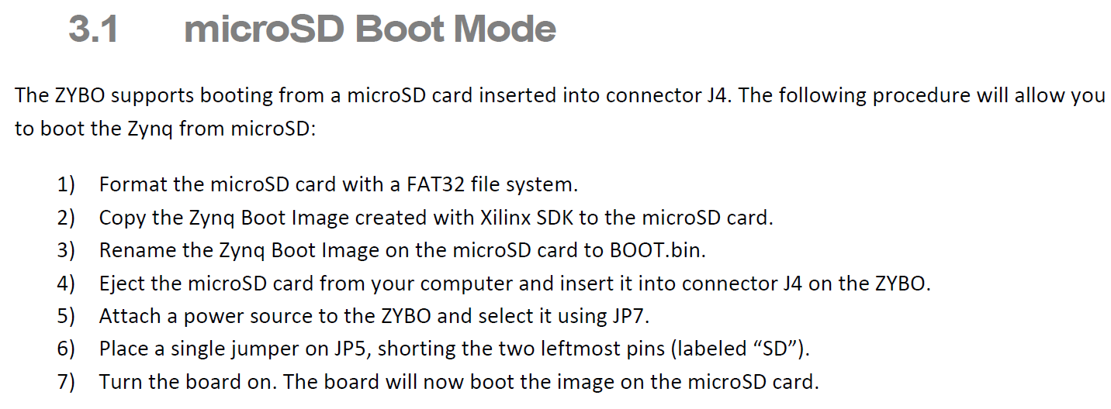
Booting procedure: From QSPI flash
Create BOOT.bin
Choose Board Support Package Settings. Choose xilffs and xilssa and OK
Create a fsbl project
File->new->Application Project and name it xxx_fsbl.
Choose use existing bsp
Choose Zynq FSBL and click Finish
Choose Xilinx Tools->Create a Zynq Boot Image (add three files in this order)
Add *.FSBL.elf (boot loader file)
Add *.bit file (hardware bit stream file)
Add u-boot.elf (Executable and Linkable file to create BOOT.bin.)
Output File name: BOOT.bin

Slide 17
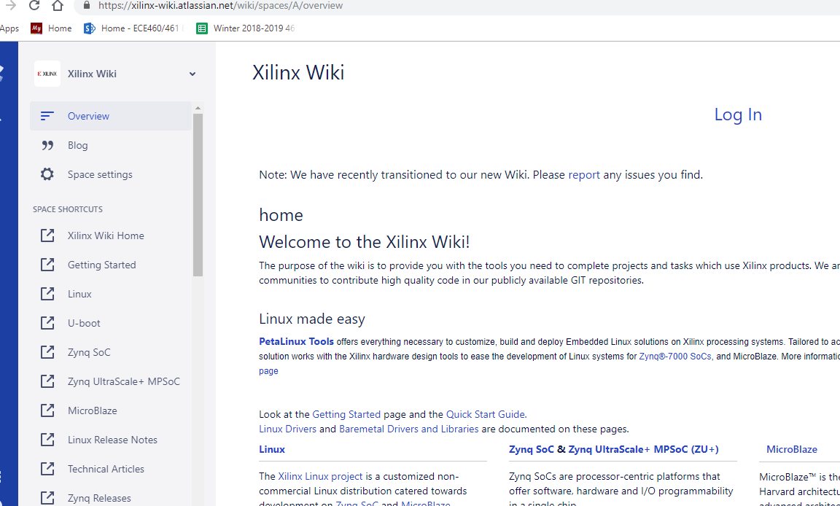
Xilinx Wiki (https://xilinx-wiki.atlassian.net/wiki/spaces/A/overview)

Slide 18
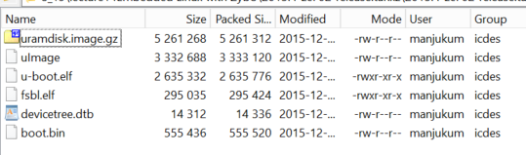
Xilinx Linux from Zynq 2015.4 Release: Ready to be Used
https://xilinx-wiki.atlassian.net/wiki/spaces/A/pages/18842271/Zynq+2015.4+Release
Boot Loader files such as FSBL, U-Boot, Linux, Device-tree Generator
2015.4-zc702-release.tar (9MB) for ZC702 Evaluation Kit only
Three releases are for ZC702, ZC706 and Zed Boards only.

Slide 19
Xilinx Linux from Zynq 2015.4 Release
Linux
Upgrade to v4.0
ZynqMP DTS file refactoring
Add support for ZC1751 DC1, DC2 and ZCU102
Add ZynqMP PCIE support
Add TPG support
ZynqMP DP fixes and various media fixes
Fixes in SPI. QSPI, DMA, ARASAN NAND. RTC and CAN
U-Boot
Upgrade to v2015.07
Fix gem for ZynqMP, different phy interface types
Add support for EMMC boot mode
Add ZynqMP ZCU102 support, ZC1751-DC5
Cleanup ZynqMP DTS files
Fix SPI DM for Microblaze
Fix build warnings for various drivers for ARM64

Slide 20
Linux from Zynq 2015.4 Release
FSBL
The First Stage Boot Loader (FSBL) used to generate the boot.bin file is based on the 2015.4 release of the Xilinx tools.
U-Boot
The release is based on U-Boot 2015.07 created from the xilinx-v2015.4 tag. More details about configuring, building and running U-Boot are located on the U-Boot and Build U-Boot pages.
Linux
The release is based on a 4.0 Linux kernel created from the xilinx-v2015.4 tag. More details about configuring, building and running Linux are located on the Linux, Zynq Linux and Build Kernel pages.
Device-tree Generator
For Vivado 2015.4 please use new device-tree generator available in https://github.com/Xilinx/device-tree-xlnx repository.

Slide 21
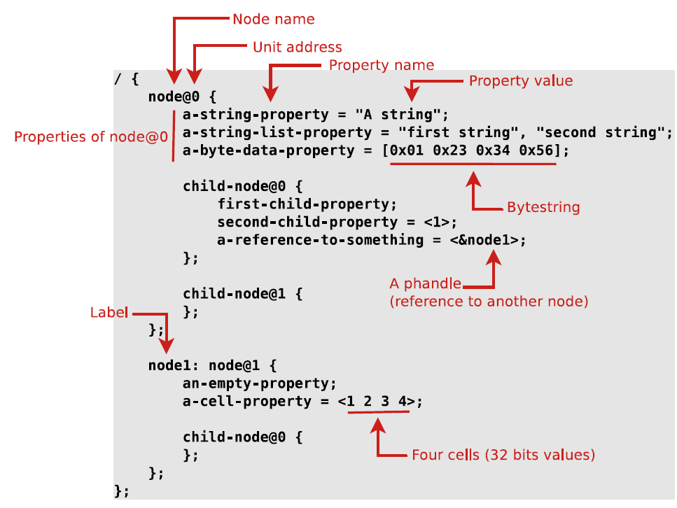

Device Tree
A device tree is a tree data structure with nodes that describe the physical devices in a system

Slide 22
From Source to Binary
On ARM, all Device Tree Source File (DTS) are for now located in arch/arm/boot/dts
.dts files for board-level definitions
.dtsi files for included files, generally containing SoC-level definitions
Device Tree Compiler compiles the source into a binary form.
Source code located in scripts/dtc
The Device Tree Blob is produced by the compiler, and is the binary that gets loaded by the bootloader and parsed by the kernel at boot time.
arch/arm/boot/dts/Makefile lists which DTBs should be generated at build time.
dtb-$(CONFIG_ARCH_MVEBU) += armada-370-db.dtb \
armada-370-mirabox.dtb \
...

Slide 23
A Simple Zybo Device Tree Source File *.dts
/* Digilent ZYBO board DTS
* Copyright (C) 2013 Xilinx, Inc.
* SPDX-License-Identifier: GPL-2.0+ */
/dts-v1/;
#include "zynq-7000.dtsi"
/ {
model = "Zynq ZYBO Board";
compatible = "xlnx,zynq-zybo", "xlnx,zynq-7000";
aliases {
serial0 = &uart1;
};
memory {
device_type = "memory";
reg = <0 0x20000000>;
};
};
Base address

Slide 24
A more complex zynq-zybo.dts
/*
* Digilent ZYBO board DTS
* Copyright (C) 2011 - 2015 Xilinx
* Copyright (C) 2012 National Instruments Corp.
* SPDX-License-Identifier: GPL-2.0+ */
/dts-v1/;
#include "zynq-7000.dtsi"
/ {
model = "Zynq ZYBO Development Board";
compatible = "digilent,zynq-zybo", "xlnx,zynq-7000";
aliases {
ethernet0 = &gem0;
serial0 = &uart1;
spi0 = &qspi;
mmc0 = &sdhci0;
};
memory {
device_type = "memory";
reg = <0x0 0x20000000>;
};
chosen {
bootargs = "earlyprintk";
stdout-path = "serial0:115200n8";
};
usb_phy0: phy0 {
#phy-cells = <0>;
compatible = "usb-nop-xceiv";
reset-gpios = <&gpio0 46 1>;
};
};
&clkc {
ps-clk-frequency = <50000000>;
};
&gem0 {
status = "okay";
phy-mode = "rgmii-id";
phy-handle = <&ethernet_phy>;
ethernet_phy: ethernet-phy@0 {
reg = <0>;
};
};
&sdhci0 {
u-boot,dm-pre-reloc;
status = "okay";
};

Slide 25
zynq-zybo.dts
&uart1 {
u-boot,dm-pre-reloc;
status = "okay";
};
&qspi {
u-boot,dm-pre-reloc;
status = "okay";
};
&usb0 {
status = "okay";
dr_mode = "host";
usb-phy = <&usb_phy0>;
};

Slide 26
Compile a DTB File under Linux
A device tree blob (DTB file) is needed to boot Linux
Get the Linux kernel source code from Digilent Git repository: https://github.com/DigilentInc/Linux-Digilent-Dev.
Default configuration for Zybo is located at arch/arm/configs/xylinx_zynq_defconfig.
There is a zynq-zybo.dts in \u-boot-digilent-master\arch\arm\dts from u-boot-digilent-master.zip
Zynq-zybo.dts files are available from a number of sources
Extensive zynq-zybo.dts and zynq-7000.dtsi in zybo_linux_bootloader.zip
Simplge zynq-zybo.dts in zynq-boot-master.zip
Simple zynq-zybo.dts in u-boot-digilent-master.zip

Slide 27
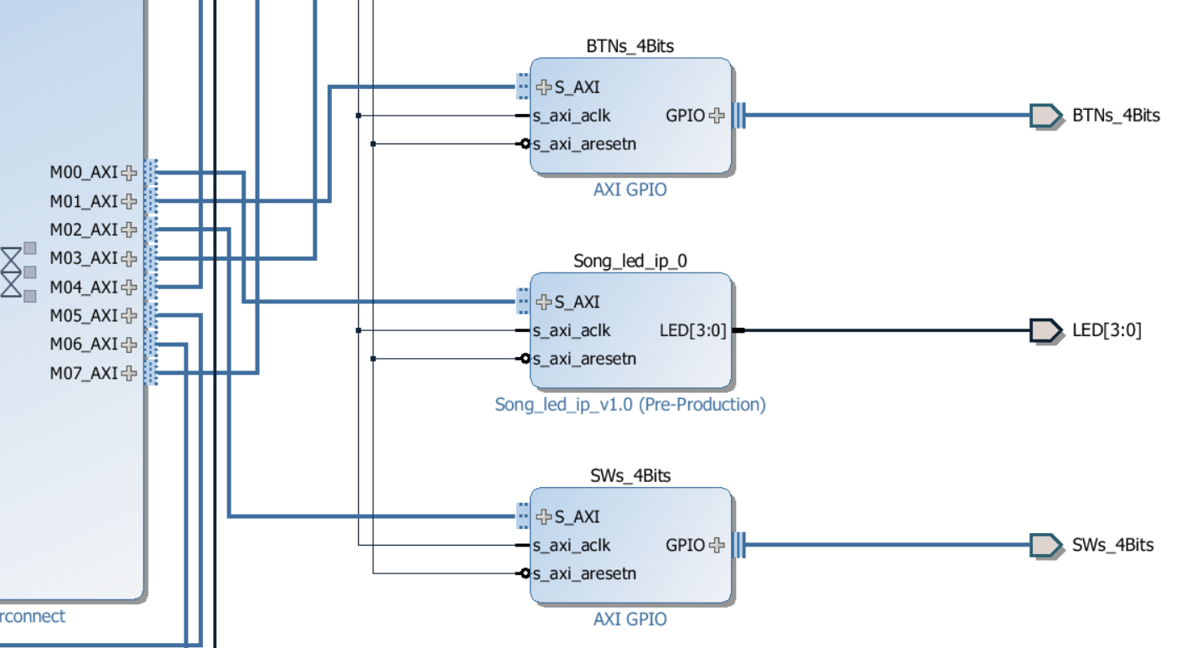
Lab #10 Block Design: Zybo Base System Design + LED IP
LED IP Device, Song_led_ip_0 needs to be added to the device tree so that Linux OS can understand it. Use your last name to name your IP.
LED IP Device needs a software driver to be inserted as a Linux process for the LED IP device.
An application program needs to be written to flash the four LEDs.

Slide 28
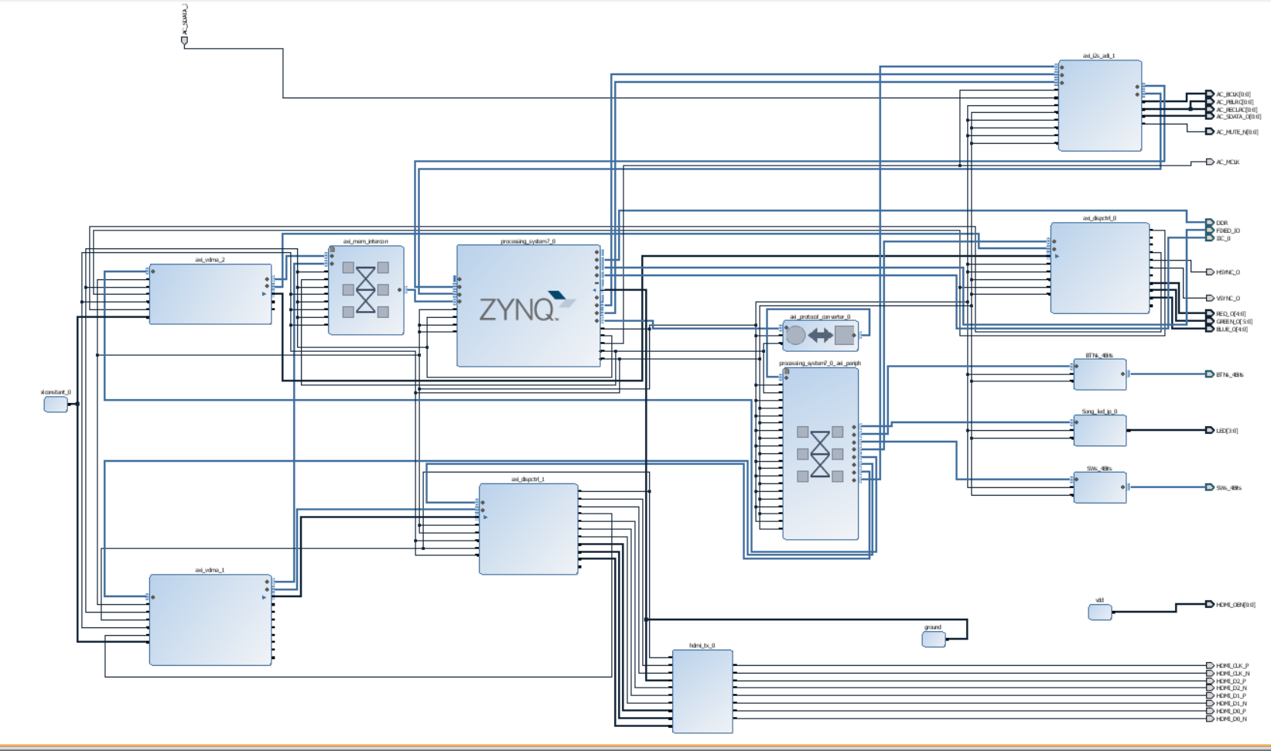
Zybo Base System Block Design with LED IP Device

Slide 29
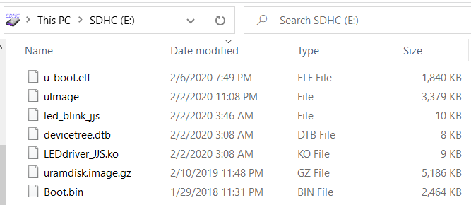
Lab #10: Create Linux Kernel Boot Loader and LED IP Driver and Program
Create the system wrapper and bit stream files for Zybo Base System Design with one LED IP device
Compile u-boot.elf under Linux environment
Create BOOT.BIN with Xilinx SDK environment
Compile uImage file as Linux kernel image
Add LED IP device to the device tree: devicetree.dtb - a device tree blob (*.dtb)
Create a disk on RAM memory: uramdisk.image.gz
Create a device driver for LED IP device: LEDdriver_JJS.ko, your name initials.
Create a LED application to flash LEDs: led_blink_jjs.c, your name initials.

Slide 30
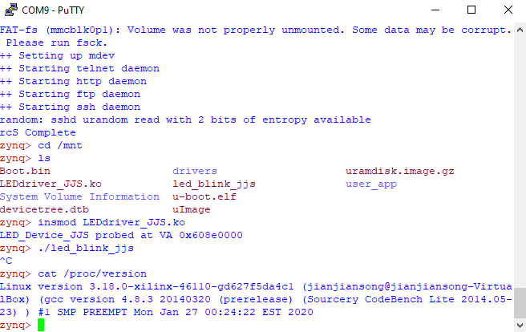
Lab #11: Demonstration Linux Kernel Boot Loader from micro SD Card
Start Linux kernel
Flash LEDs
Show kernel version:
Cat /proc/version

Slide 31
Lab #10: References and Resources
“Guidelines on VirtualBox Ubuntu and Xilinx SDK 2014”, by David Robinson and Jianjian Song
To install Oracle VirtualBox to start Ubuntu Linux
Lab #10 Embedded Linux with Zybo handout
“Embedded Linux® Hands-on Tutorial for the ZYBO™”, Revised July 17, 2014, Digilent Inc.
Xilinx Vivado and SDK to create hardware design
Xilinx Linux software development cross-compiler tool chain for ARM Cortex-A9
Linux-Digilent-Dev.git and u-boot-Digilent-Dev.git archives, https://github.com/DigilentInc.
RAM Disk source code. arm_ramdisk.image.gz in Build and Modify a Rootfs, http://www.wiki.xilinx.com.
myled.c driver code and led_blink.c application code from Digilent.

Slide 32
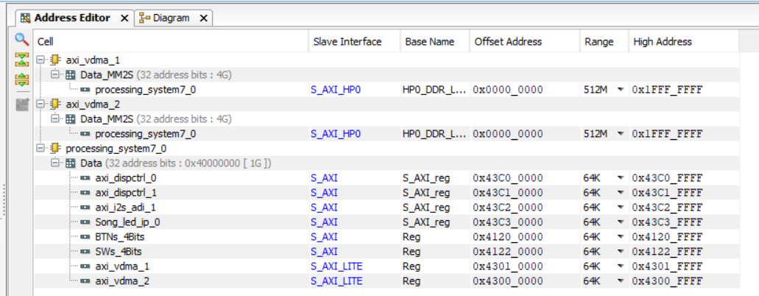
Add LED IP, Song_led_ip_0 to Zybo Base System Design
Song_led_ip_0 address is mapped to processing system7_0/Data as address 0x43C30000
This is the address ARM knows and accesses Song_led_ip_0

Slide 33
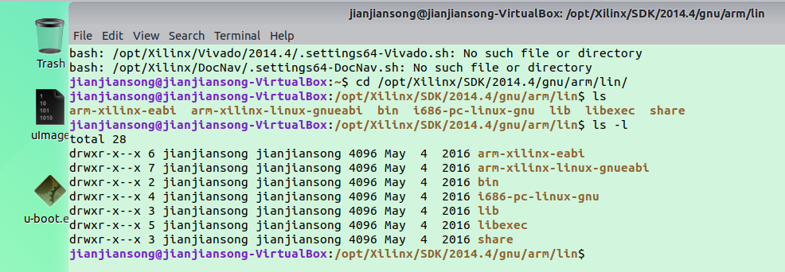
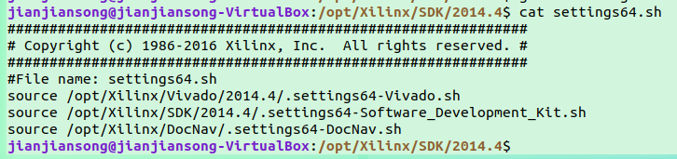
Install and Enable Vivado 2014.4 Cross-Compile Tool Chain
These tools are zipped into a file Xilinx.zip, available from instructor
The tools need to be unzipped and copied to /opt/Xilinx/SDK/2014.4
source /opt/Xilinx/Vivado/2014.4/.settings64.sh to enable these tools

Slide 34
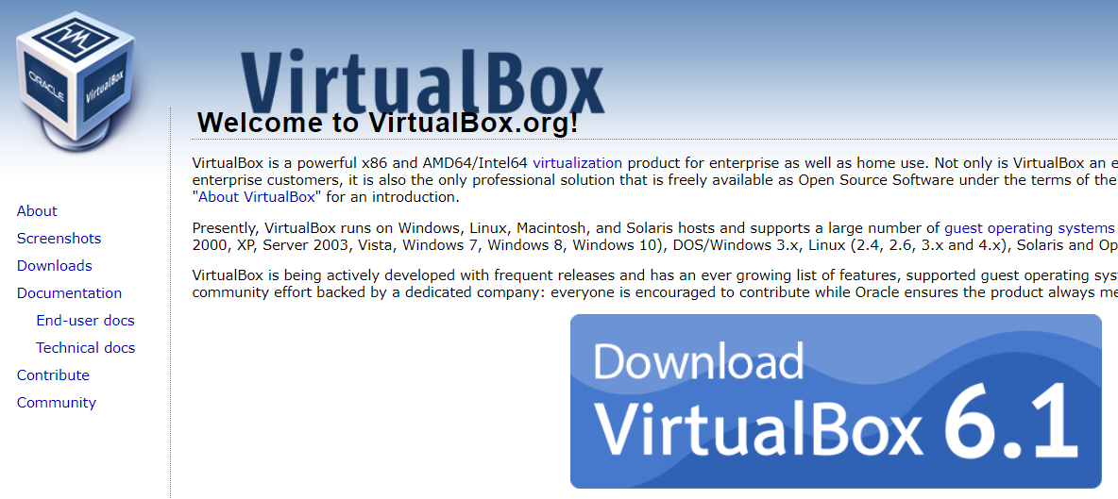
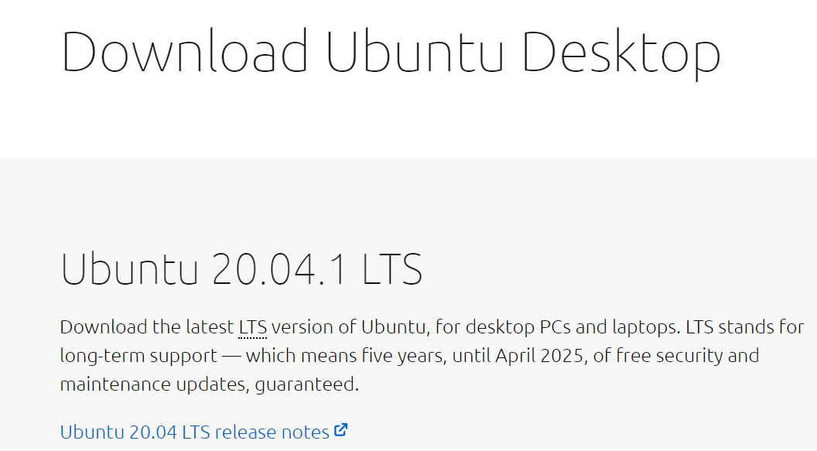
Install Oracle VirtualBox and Ubuntu Linux Virtual Machine
Follow “Guidelines on VM VirtualBox and Ubuntu Linux with Xilinx SDK”
Install Oracle VirtualBox from https://www.virtualbox.org/.
Download an Ubuntu ISO. (https://www.ubuntu.com/download/desktop)

Slide 35
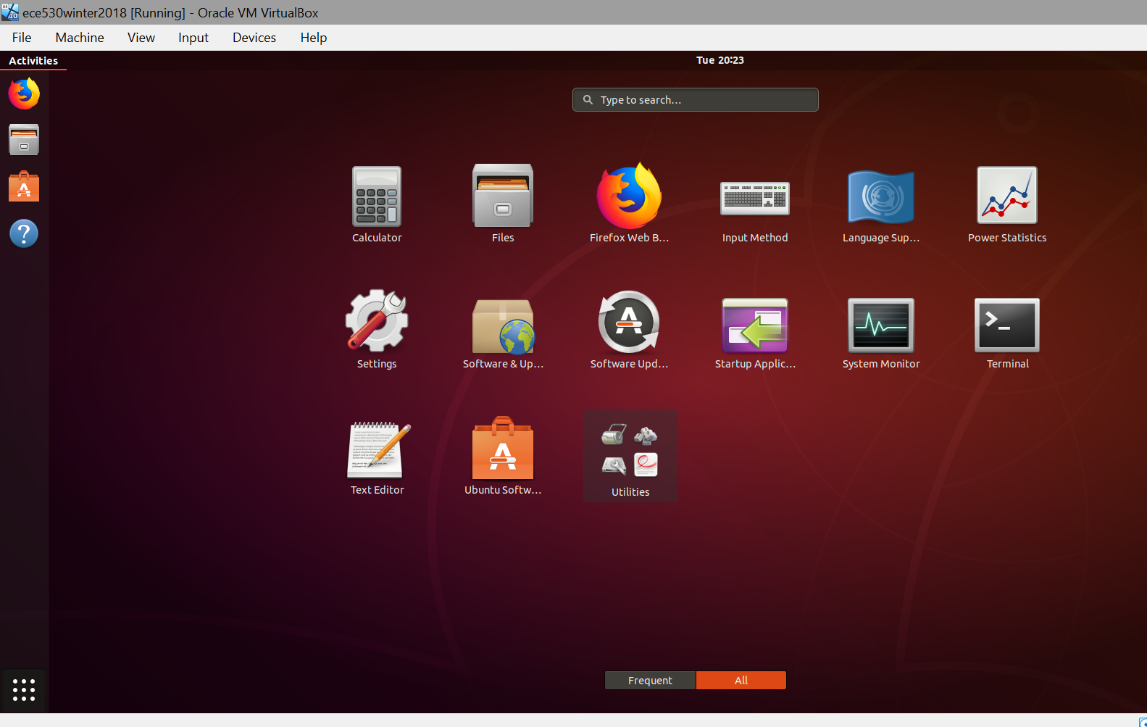
Ubuntu Linux Virtual Machine under Oracle VirtualBox

Slide 36
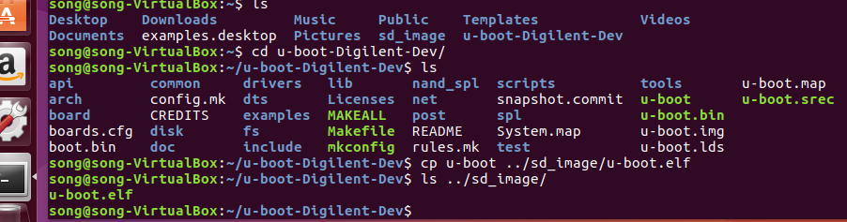
Compile a u-boot under Linux: u-boot.elf
To install git to download source files
bash>sudo apt-get install git
Downloading the source tree for U-Boot
Clone source code for U-Boot from the Digilent Git repository
Compiling u-boot for the target device
Add surfix .elf to the compiled ELF (Executable and Linkable File) u-boot to name it u-boot.elf.

Slide 37
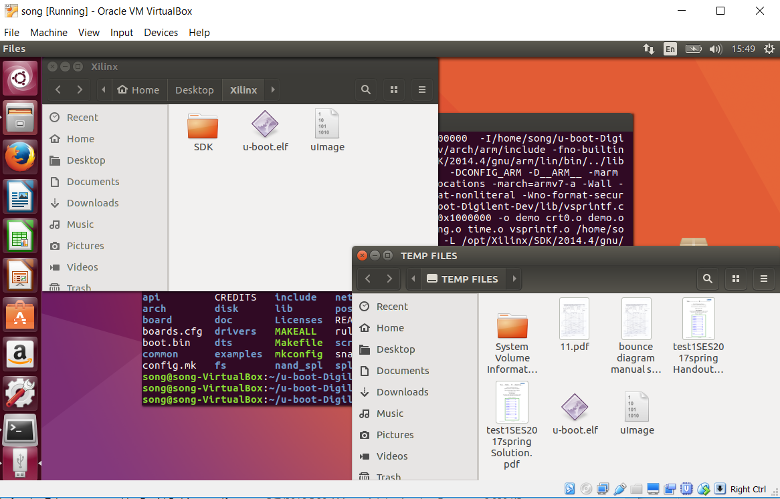
File Transfer between VM VirtualBox and Windows
Open a flash drive in VirtualBox: Devices->USB->Flash
Drag a file between a folder in VirtualBox to a folder on Flash Drive

Slide 38
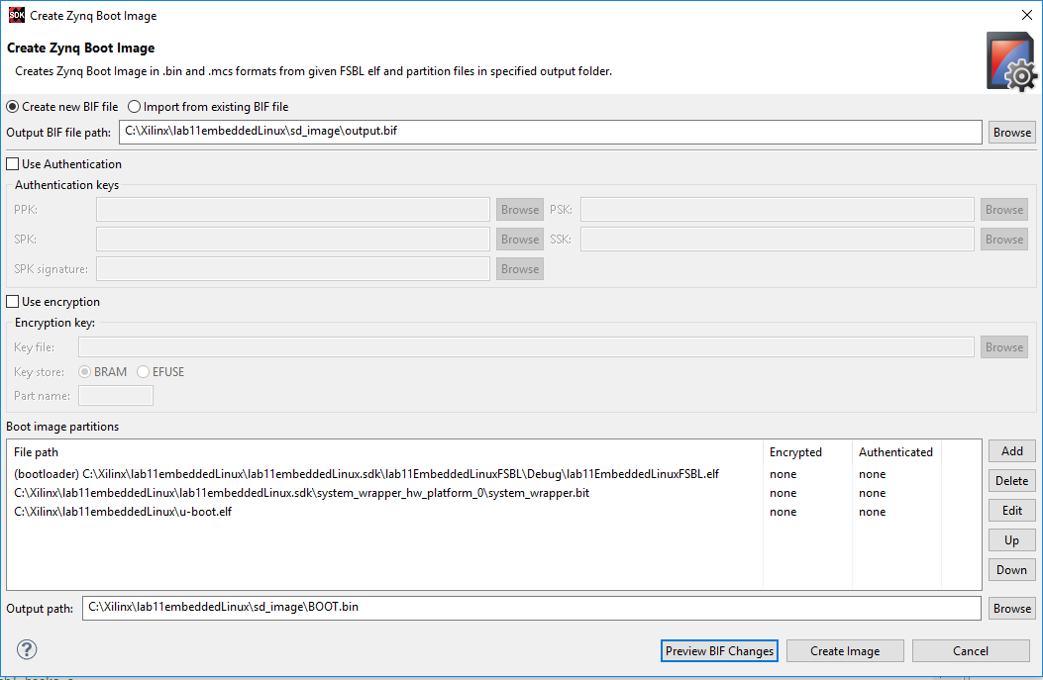
Generate BOOT.BIN with the new u-boot.elf
Once u-boot.elf file is generated, it needs to be wrapped into a boot.bin file.
Boot.bin contains three files: FSBL.elf, system_wrapper.bit, u-boot.elf

Slide 39
Linux Kernel and File System Configuration
Get git clone from https://github.com/DigilentInc/Linux-Digilent-Dev.git
Add tools path
$ PATH=$PATH:~/u-boot-Digilent-Dev/tools
Install u-boot-tools to run mkimage, (apt is newer than apt-get)
$ sudo apt install u-boot-tools
Use Default Kernel Configuration for Zybo
$ make ARCH=arm CROSS_COMPILE=arm-Xilinx-linux-gnueabi- Xilinx_zynq_defconfig
Compile Kernel object files first
$ make ARCH=arm CROSS_COMPILE=arm-Xilinx-linux-gnueabi-
Run scripts
$ make ARCH=arm CROSS_COMPILE=arm-Xilinx-linux-gnueabi-scripts/kconfig/config
Generate uImage file with load address at 0x8000
$ make ARCH=arm CROSS_COMPILE=arm-Xilinx-linux-gnueabi- UIMAGE_LOADADDR=0x8000 uImage
Chapter 3 Boot and Configuration, ug821 Zynq-7000 Software Development Guide

Slide 40
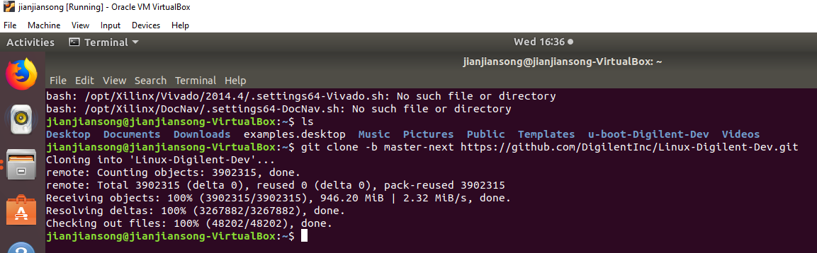
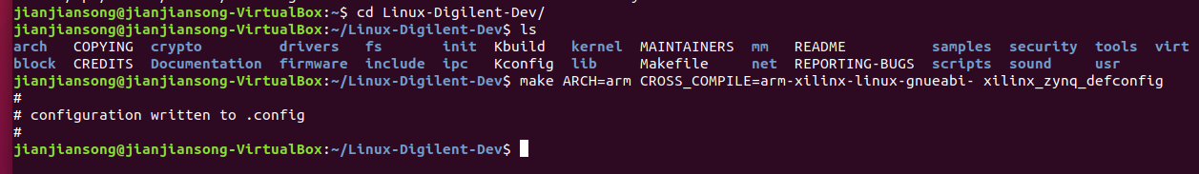
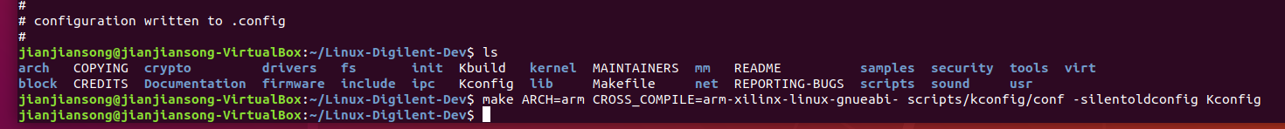
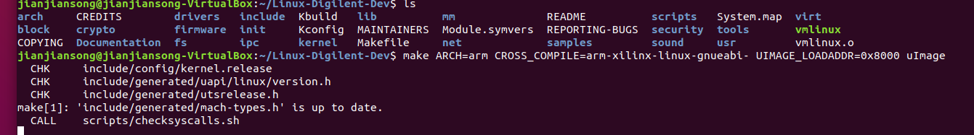

Slide 41
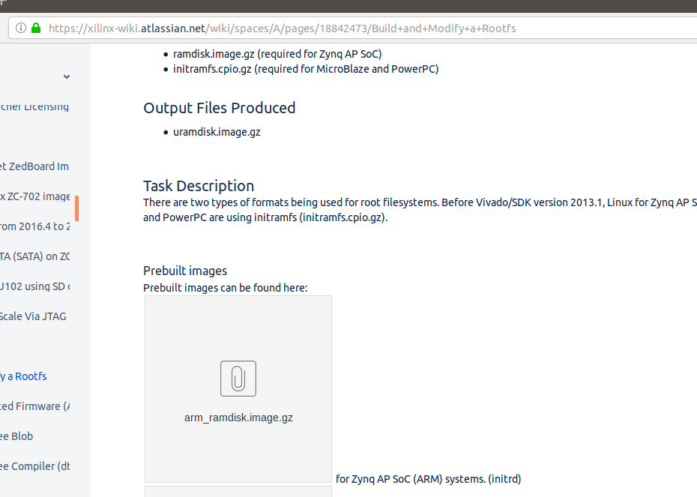
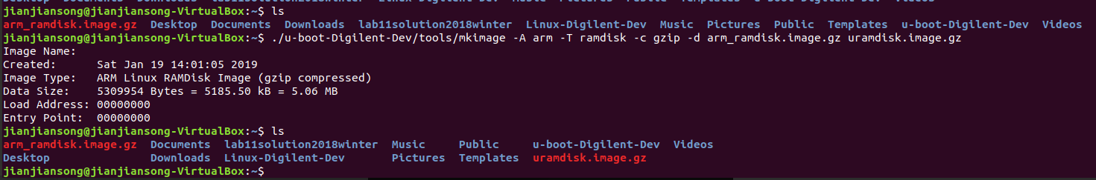
Make RAM disk
Get ram disk source file from www.wiki.xilinx.com

Slide 42
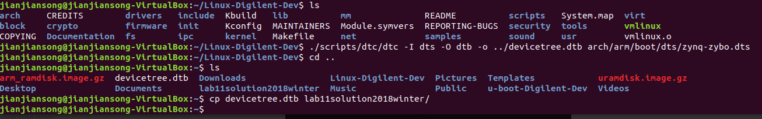
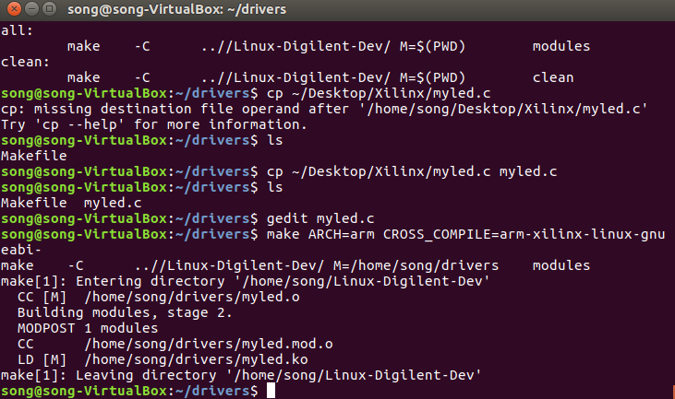
Make device tree blob and device driver from myled.c

Slide 43
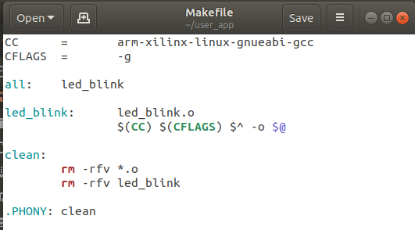
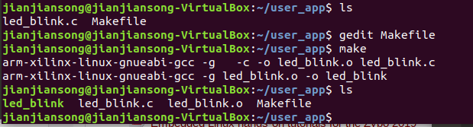
Make led blink executable from led_blink_jjs.c

Slide 44
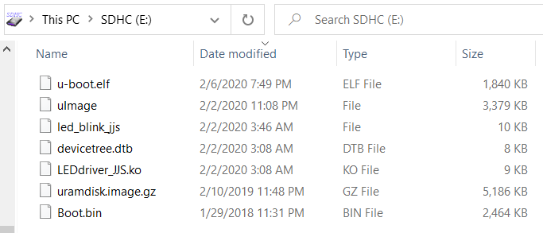
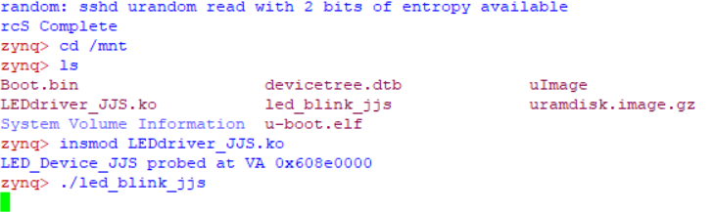
Lab #19: Demonstration Linux Kernel Boot Loader from micro SD Card
Start a terminal such as Putty or HyperTerminal
Start Linux kernel from MicroSD
Flash the four LEDs

